Slide 1
Project Joseph Hoane
Esha Gadgil, John Nesnidal, Savannah Franklin, Will Norris, Jared Wong

Slide 2
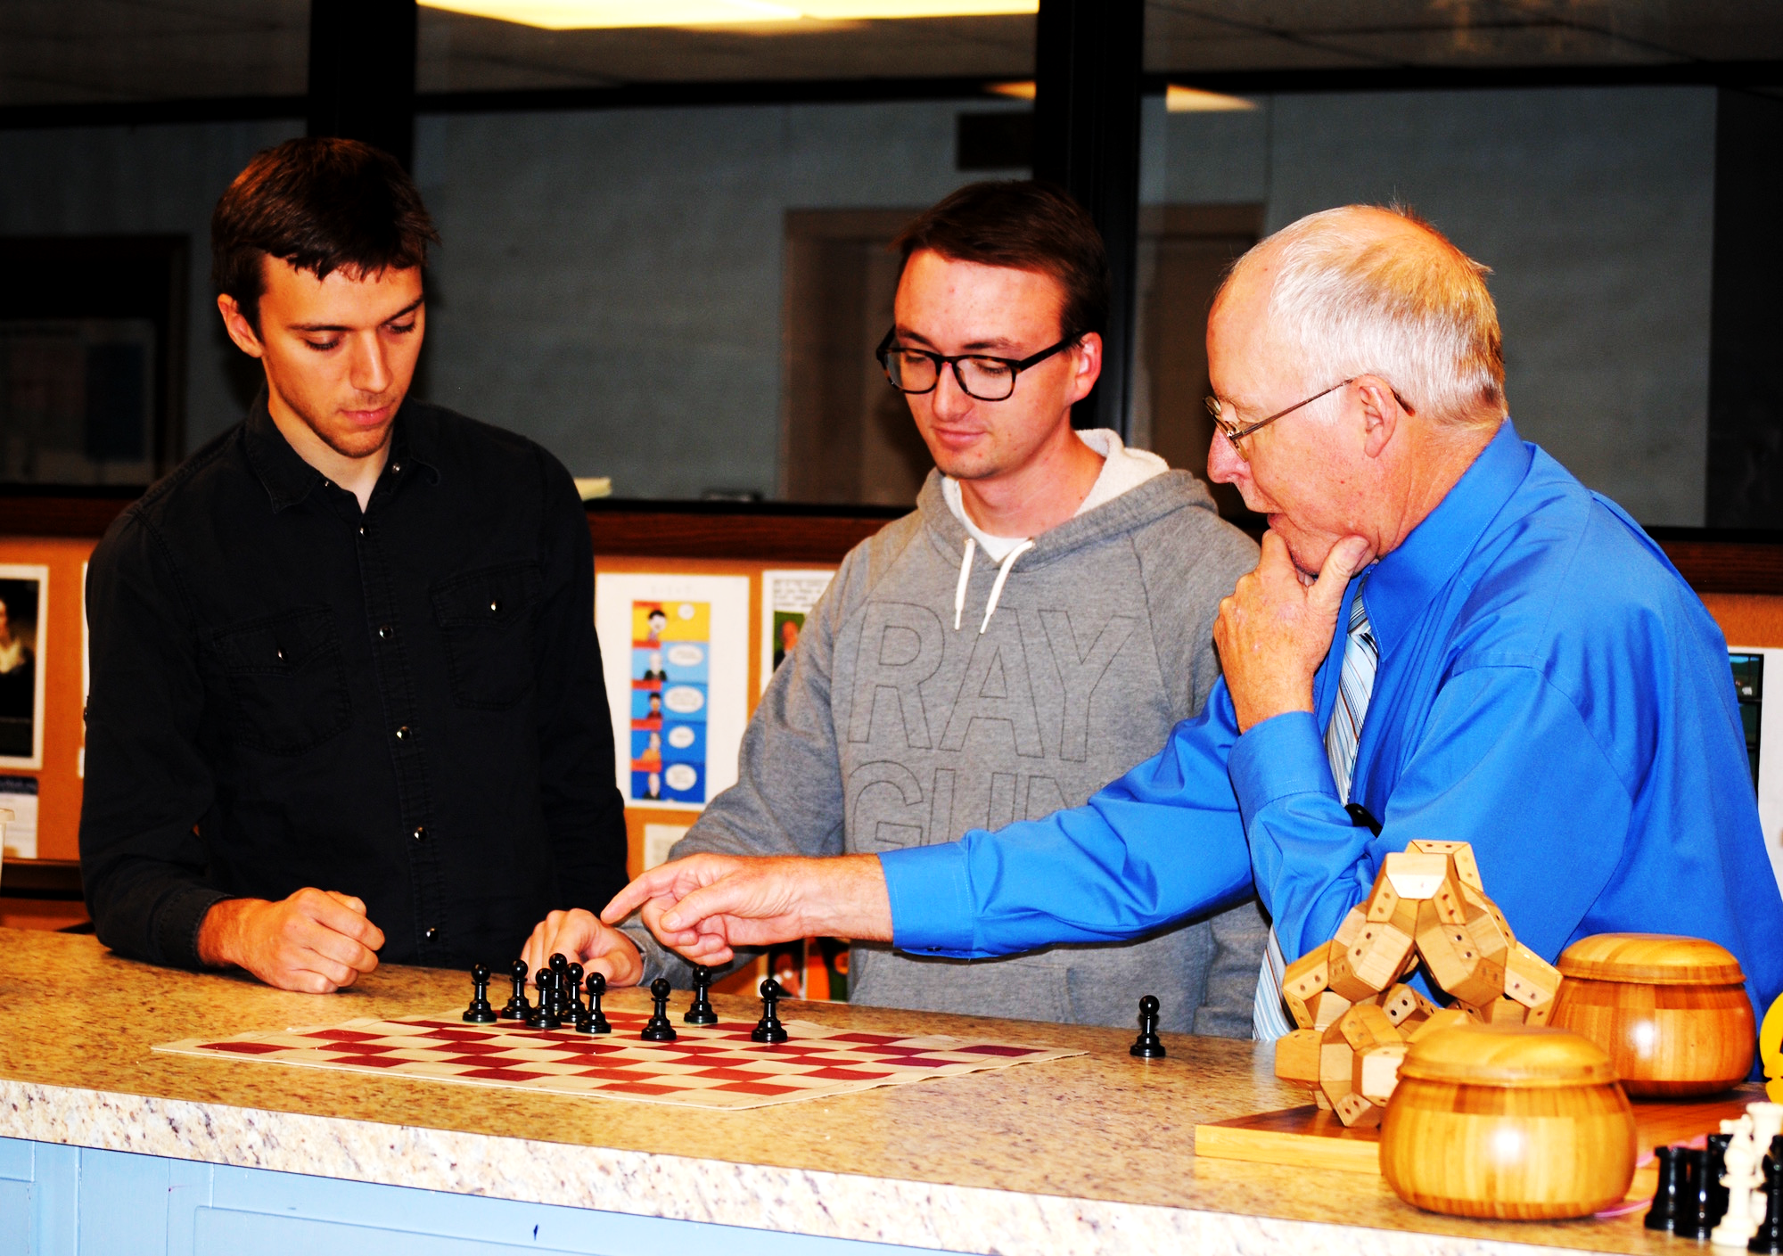
History
Joseph Hoane Jr. - computer scientist involved in IBM’s Deep Blue chess engine project
Lacked one thing: couldn’t interact with the board
Hoane had to move the pieces on behalf of the machine
How do we make a robotic chess player that can actually play chess?

Slide 3
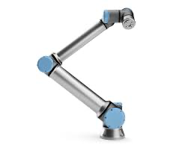
Project Overview
Develop a fully autonomous UR10e robotic system capable of playing chess against a human opponent or another robot. This project integrates advanced robotics, artificial intelligence, and strategic algorithmic problem-solving to achieve seamless interaction and precise gameplay

Slide 4



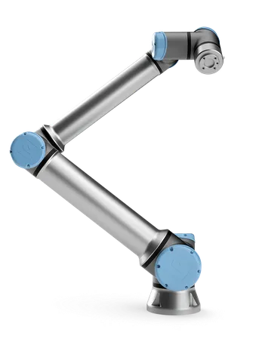

Client and Equipment
Client: Dr. Bowen Weng
How will the robot see the chessboard?
GoPro Camera
QR Codes or April Tags
How will the robot move the pieces?
Universal Robotics UR10e Robot Arm

Slide 5
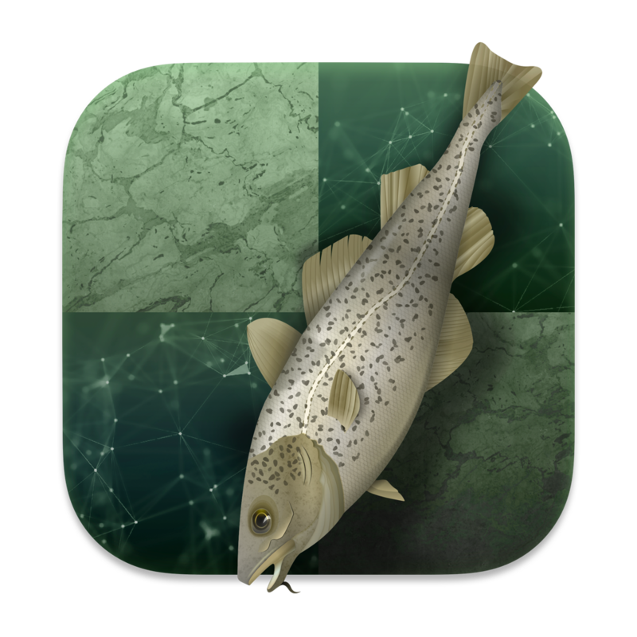


Key Project Components
Stockfish
Open-Source Chess Engine
OpenCV
Computer Vision Library
ROS
Robot Operating System
Gazebo
Robot Simulator

Slide 6
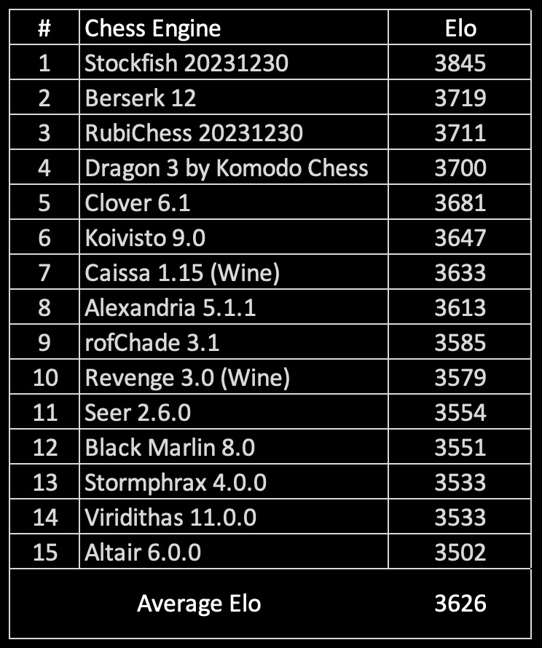
Stockfish
What is Stockfish?
Free, open-source, chess engine
Considered the strongest chess engine available to the public
Why we picked Stockfish over other chess engines
Top rated
Higher Elo compared to other engines
How are we going to use Stockfish?
In order to input raw chess move data into Stockfish, we need a way for the robot to visualize and process the board

Slide 7
OpenCV
What is OpenCV?
Open Source Computer Vision Library
Provides tools for image and video processing
Supports multiple programming languages (e.g., Python, C++, Java)
Extensive range of functions for image manipulation, object detection, and more
Why Use OpenCV for Chess?
Analyzes the chessboard grid.
Detects QR codes on chess pieces.
Captures and processes live video from GoPro.

Slide 8
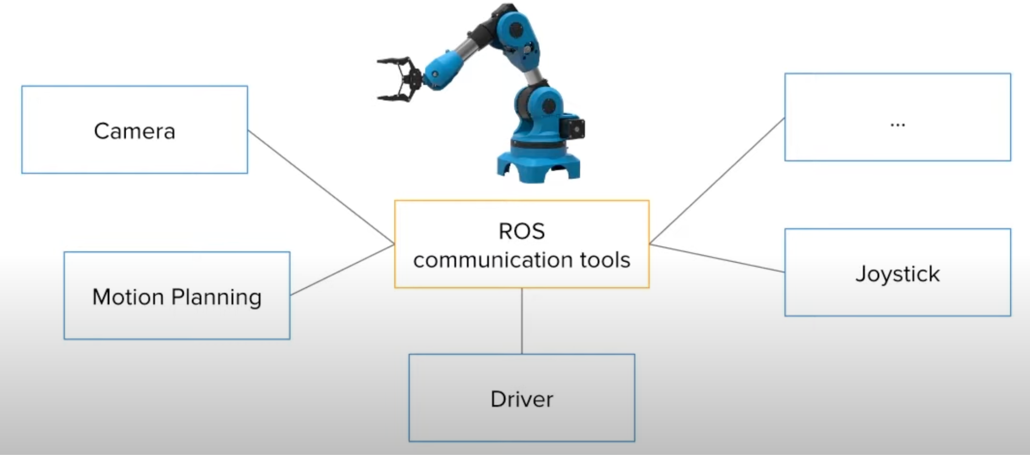
ROS (Robot Operating System)
What is ROS?
Open-source framework designed to facilitate the development of robotic applications
Provides essential tools, libraries, and drivers to control hardware
Why ROS?
Acts as a middleware and framework built for robotics applications
ROS has drivers for both the robot arm and the gripper
Includes a simulator that can be used to test the robot arm virtually
Great for beginners
Plug & Play Libraries

Slide 9
Development Plan
Phase 1: Software Setup (complete)
Development environment setup
Stockfish integration and tests
ROS integration and tests
Robot simulator setup and tests
Phase 2: Hardware Setup
Integration with physical robot arm
Camera installation and setup
OpenCV integration and tests
Interface between OpenCV and Stockfish
Robot arm calibration
Phase 3: Actually Playing Chess
Interface between Stockfish and robot arm
Robot arm motions
Final debugging

Slide 10
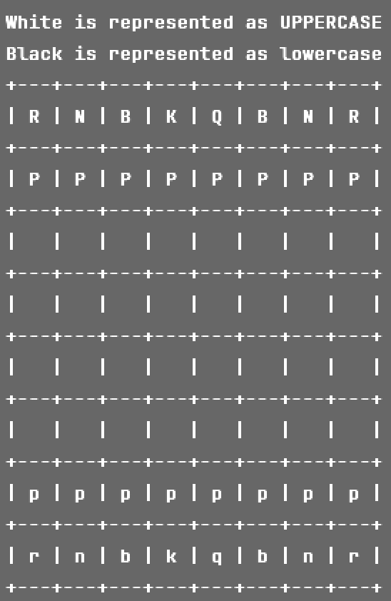
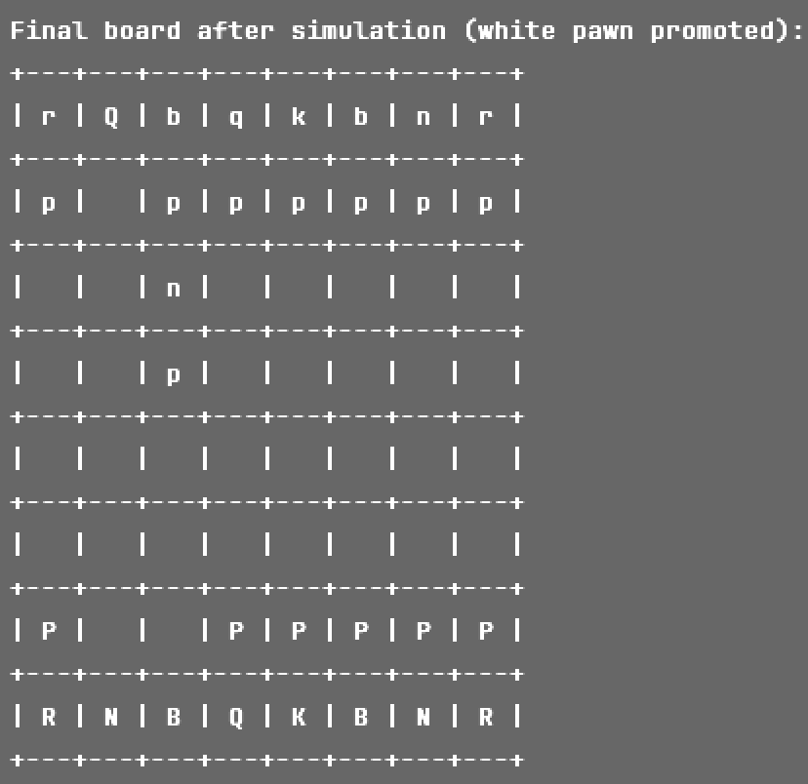
Stockfish Setup and Integration

Slide 11

Robot Arm Simulation (Gazebo)

Slide 12
Next steps
1. Test Existing Code on the Actual Robot Arm
Verify the robot arm's movement is consistent with the simulated behavior
Observe the arm's trajectory to ensure smooth and accurate motions
Use safety measures like emergency stops during initial testing
2. Calibrate the Robot Arm with the Chessboard
Physically measure and set the chessboard's position relative to the robot base
Run calibration scripts to align the end effector with specific board squares
Fine-tune joint angles based on calibration results
Test the robot's ability to consistently move to predefined board positions
Ensure accuracy when picking and placing chess pieces

Slide 13
Questions?

